Slide 1

Techno Main Salt Lake
EM-4/1, Sector-V, Salt Lake City, Kolkata- 700091
A Novel Community and Family Centric Healthy Meal Planner Integrating Nutritional Information, User Preferences, and Regional Context
- Presented by
Rohan Banerjee (13000122001)
Sasshtik Trivedi (13000122006)
Sanjit Dutta (13000122007)
Sibele Pal (13000122048)
- Under the guidance of Prof. Poulami Dutta
22-12-2025
@Dept. of CSE, TMSL
1

Slide 2
GR22-A Novel Community and Family Centric Healthy Meal Planner Integrating Nutritional Information, User Preferences, and Regional Context
Contents
Introduction
Motivation and Problem Statement
Objectives and Contributions
Literature Review
Dataset Description and Integration
Data Preprocessing
Feature Extraction
System Architecture Overview
Model Development
Matrix Factorization
Transformer Sequence Model
Content-Based Similarity
Attention-Based Fusion Mechanism
Training and Evaluation Strategy
Recommendation Generation and Serving
Experimental Results and Visual Analysis
Key Findings and Discussion
Future Scope and Enhancements
Conclusion
References
22-12-2025
@Dept. of CSE, TMSL
2

Slide 3
GR22-A Novel Community and Family Centric Healthy Meal Planner Integrating Nutritional Information, User Preferences, and Regional Context
Motivation
The motivation behind our project are:
Addressing Health Risks Through Intelligent Food Recommendations
Lifestyle diseases such as diabetes, obesity, and hypertension are increasing rapidly due to unhealthy eating habits. Existing food platforms prioritize popularity and taste, often ignoring nutritional suitability and health constraints.
Incorporating Regional and Cultural Food Diversity
India’s dietary practices vary significantly across regions and cultures. Most current recommendation systems fail to consider regional food habits, leading to impractical and culturally irrelevant suggestions.
Applying ML and DL for Health-Aware Personalization
This project leverages hybrid machine learning and deep learning models to integrate user preferences, health conditions, allergies, and activity levels. The goal is to deliver scalable, responsible, and personalized food recommendations, forming a foundation for future family-centric meal planning.
22-12-2025
@Dept. of CSE, TMSL
3

Slide 4
GR22-A Novel Community and Family Centric Healthy Meal Planner Integrating Nutritional Information, User Preferences, and Regional Context
Introduction
In the age of digital transformation, food delivery and nutrition platforms play a crucial role in shaping daily dietary habits. However, most existing food recommendation systems focus primarily on user preferences and popularity, often overlooking nutritional balance, health conditions, and regional dietary practices.
This project aims to bridge this gap by developing a region-aware and health-constrained food recommendation system. By leveraging machine learning and deep learning techniques, the system generates personalized food recommendations based on user health conditions, dietary goals, allergies, activity levels, and regional preferences. The proposed prototype supports informed and safer food choices and lays the foundation for future extensions into family-centric meal planning and community-based dietary management.
22-12-2025
@Dept. of CSE, TMSL
4

Slide 5
GR22-A Novel Community and Family Centric Healthy Meal Planner Integrating Nutritional Information, User Preferences, and Regional Context
Problem Statement
The growing incidence of lifestyle-related health issues such as obesity, diabetes, and cardiovascular diseases highlights the importance of informed and balanced dietary planning. Although numerous digital food and meal-planning platforms exist, most focus on individual preferences or calorie tracking, while overlooking nutritional balance, health conditions, allergies, regional food habits, and family-level coordination.
Additionally, current systems lack support for community and family-centric meal planning, which is essential in culturally diverse societies like India where meals are often shared. To address these limitations, this project proposes a novel community and family-centric healthy meal planner that integrates nutritional information, user preferences, health constraints, and regional context to deliver practical, health-aware, and culturally relevant meal planning solutions.
22-12-2025
@Dept. of CSE, TMSL
5

Slide 6
GR22-A Novel Community and Family Centric Healthy Meal Planner Integrating Nutritional Information, User Preferences, and Regional Context
Our Contribution
Designed and implemented a region-aware and health-constrained food recommendation prototype that personalizes food suggestions based on user health conditions, allergies, dietary goals, activity level, and regional food preferences.
Developed a hybrid recommendation framework integrating collaborative filtering concepts, content-based food representations, and rule-based health and safety constraints to balance personalization with nutritional responsibility.
Engineered nutritional, lifestyle, and contextual features from food and user data, enabling health-compliant ranking while preserving recommendation diversity.
Incorporated health penalty and allergy filtering mechanisms to prevent unsafe or unsuitable food recommendations, improving user safety and system reliability.
Built a modular and scalable system architecture, with clearly defined input–output schemas and processing pipelines, suitable for future extension into family-centric recommendations and complete meal planning (breakfast, lunch, dinner).
22-12-2025
@Dept. of CSE, TMSL
6

Slide 7
GR22-A Novel Community and Family Centric Healthy Meal Planner Integrating Nutritional Information, User Preferences, and Regional Context
Dataset Preparation
Dataset:
Multiple datasets are used, including:
Food nutrition datasets (403095, 11)
Macro- and micro-nutrient values (5000, 14)
User lifestyle and health datasets (5000, 12)
Food safety alert datasets (30780, 6)
Synthetic user–food interaction datasets (500, 16)
Preprocessing Steps:
Missing Value Handling: Nutritional gaps handled via controlled imputation to ensure stable model training.
Unit Standardization: All nutrients normalized to consistent measurement units (per 100g).
Categorical Encoding: Region, health condition, and dietary goals encoded for model compatibility.
Unified Food ID Mapping: Consistent food identifiers assigned across all datasets for seamless integration.
22-12-2025
@Dept. of CSE, TMSL
7

Slide 8
GR22-A Novel Community and Family Centric Healthy Meal Planner Integrating Nutritional Information, User Preferences, and Regional Context
Existing Solutions
Several approaches have been explored for food recommendation and dietary planning using machine learning, nutrition science, and user preference modeling. These solutions vary in scope, data usage, and level of personalization:
Nutrition-Aware Food Recommendation Systems (2021–2023): Several studies integrate nutritional information (calories, fat, sugar, protein) with user preferences using collaborative filtering and multi-objective optimization. These systems improve health-aware personalization compared to traditional recommenders but are largely limited to individual users and lack regional and family-level planning.
Deep Learning-Based Food Recommendation Models: Recent works employ deep neural networks and sequence-based models to capture complex dietary behavior from user history. While these models outperform classical methods like matrix factorization, most do not explicitly incorporate health constraints, allergies, or nutritional safety.
22-12-2025
@Dept. of CSE, TMSL
8

Slide 9
GR22-A Novel Community and Family Centric Healthy Meal Planner Integrating Nutritional Information, User Preferences, and Regional Context
Existing Solutions
Rule-Based Diet Recommendation Systems: Rule-based approaches are widely used for chronic disease management by enforcing predefined dietary guidelines. Although effective for medical compliance, these systems are rigid, offer limited personalization, and scale poorly across diverse users and dietary preferences.
Context-Aware and Group-Based Recommendation Systems: Some studies incorporate contextual factors such as lifestyle, time, location, or group preferences to improve recommendation relevance. Group-based systems show higher satisfaction but often lack comprehensive integration of nutrition, health constraints, regional context, and food safety within a unified framework.
22-12-2025
@Dept. of CSE, TMSL
9

Slide 10
GR22-A Novel Community and Family Centric Healthy Meal Planner Integrating Nutritional Information, User Preferences, and Regional Context
Proposed Methodology
Data Collection
Datasets Used:
Food Nutrition Datasets:
Contain macro- and micro-nutrient values such as calories, protein, fat, sugar, fiber, and sodium.
Used to evaluate the nutritional suitability of food items for different health conditions and dietary goals.
User Lifestyle & Health Datasets:
Capture user-specific attributes including dietary goals, health conditions, allergies, activity levels, and food awareness.
Enable personalized and health-aware recommendation generation.
Food Safety Alert Datasets:
Provide information about potentially unsafe or restricted food categories.
Used for safety-aware filtering and penalization during recommendation ranking.
Synthetic User–Food Interaction Datasets:
Simulate realistic food consumption patterns in the absence of real interaction logs.
Required for training machine learning and deep learning recommendation models.
22-12-2025
@Dept. of CSE, TMSL
10

Slide 11
GR22-A Novel Community and Family Centric Healthy Meal Planner Integrating Nutritional Information, User Preferences, and Regional Context
Proposed Methodology
Dataset Integration:
All datasets are merged into a unified structured dataset.
Consistent food identifiers are assigned across nutrition, safety, and interaction data.
User attributes are aligned with interaction records to enable seamless feature extraction and model training.
22-12-2025
@Dept. of CSE, TMSL
11

Slide 12
GR22-A Novel Community and Family Centric Healthy Meal Planner Integrating Nutritional Information, User Preferences, and Regional Context
Proposed Methodology
Data Preprocessing
Data Cleaning
Removed duplicate and inconsistent food records to ensure a reliable item catalog.
Handled missing nutritional values using controlled imputation to maintain numerical stability.
Eliminated invalid or incomplete user entries to prevent biased learning during model training.
Standardization & Encoding
Standardized nutrient values (calories, protein, fat, sugar, sodium) to common measurement units.
Encoded categorical attributes such as region, cuisine type, health condition, and activity level into model-compatible formats.
Assigned unique food identifiers to enable consistent mapping across nutrition, safety, and interaction datasets.
Health & Safety Handling
Flagged food items conflicting with declared user allergies as strict exclusion constraints.
Marked foods unsuitable for specific health conditions to apply health-aware penalties.
Integrated food safety alerts to penalize or filter high-risk food items during recommendation.
22-12-2025
@Dept. of CSE, TMSL
12

Slide 13
GR22-A Novel Community and Family Centric Healthy Meal Planner Integrating Nutritional Information, User Preferences, and Regional Context
Proposed Methodology
3. Feature Extraction
Food Feature Embeddings
Generated structured food representations using nutritional attributes such as calories, macronutrients, fiber, and sodium.
Incorporated region and cuisine tags to preserve cultural and dietary relevance.
Included food safety risk indicators as additional features for safety-aware ranking.
User Feature Representation
Encoded user health conditions, dietary goals, allergies, and activity levels.
Modeled lifestyle attributes to align recommendations with daily energy requirements.
Preference & Context Features
Utilized user–food interaction history (where available) to simulate preference learning.
Integrated regional context to ensure recommendations remain region-specific and culturally appropriate.
22-12-2025
@Dept. of CSE, TMSL
13

Slide 14
GR22-A Novel Community and Family Centric Healthy Meal Planner Integrating Nutritional Information, User Preferences, and Regional Context
Proposed Methodology
4. Model Development
Recommendation Models Used:
Collaborative Filtering (Matrix Factorization)
Learns long-term user preference patterns from user–food interaction data.
Captures stable consumption behavior using latent user and food embeddings.
Sequence-Based Modeling (Transformer Architecture)
Models short-term eating behavior by learning sequential food consumption patterns.
Uses attention mechanisms to focus on recent and relevant food choices.
Content-Based Similarity Models
Leverages nutritional, regional, and categorical food attributes.
Supports cold-start users and newly introduced food items.
Hybrid Recommendation Strategy
Combined outputs from collaborative filtering, sequence modeling, and content-based similarity models.
Enforced health-condition penalties, allergy-based filtering, and food safety constraints during ranking.
Final recommendation score balances:
Preference relevance
Nutritional suitability
Regional and cultural context
22-12-2025
@Dept. of CSE, TMSL
14

Slide 15
GR22-A Novel Community and Family Centric Healthy Meal Planner Integrating Nutritional Information, User Preferences, and Regional Context
Proposed Methodology
5. Attention-Based Fusion Mechanism
Applied an attention-based fusion layer to combine:
Sequence-level food consumption representation
Static user preference embedding
Attention mechanism dynamically learns the relative importance of:
Recent eating behavior
Long-term preference patterns
Produces a unified representation used for final recommendation scoring.
6. Model Training & Evaluation
Training Process
Models are trained independently using neural network-based optimization techniques.
Matrix Factorization uses interaction-based loss functions.
Sequence model uses cross-entropy loss for next-food prediction.
22-12-2025
@Dept. of CSE, TMSL
15

Slide 16

GR22-A Novel Community and Family Centric Healthy Meal Planner Integrating Nutritional Information, User Preferences, and Regional Context
Proposed Methodology
Evaluation Approach
Model Evaluation Strategy
Model performance is evaluated using training loss convergence across epochs.
A monotonically decreasing loss curve indicates:
Stable gradient updates
Effective feature learning
Absence of model divergence
Since the system is recommendation-based, loss behavior is the primary indicator of learning quality rather than classification accuracy.
Matrix Factorization (MF) – Loss Function
The MF model is trained using Binary Cross-Entropy Loss with Logits.
Each user–food interaction is modeled as:
Positive interaction (label = 1)
Negative sampled interaction (label = 0)
Loss Formula:
22-12-2025
@Dept. of CSE, TMSL
16

Slide 17

GR22-A Novel Community and Family Centric Healthy Meal Planner Integrating Nutritional Information, User Preferences, and Regional Context
Proposed Methodology
Evaluation Approach
Model Evaluation Strategy
Model performance is evaluated using training loss convergence across epochs.
A monotonically decreasing loss curve indicates:
Stable gradient updates
Effective feature learning
Absence of model divergence
Since the system is recommendation-based, loss behavior is the primary indicator of learning quality rather than classification accuracy.
Matrix Factorization (MF) – Loss Function
The MF model is trained using Binary Cross-Entropy Loss with Logits.
Each user–food interaction is modeled as:
Positive interaction (label = 1)
Negative sampled interaction (label = 0)
Loss Formula:
Where:
​ → predicted interaction score
→ user and food embeddings
σ(⋅) → sigmoid activation
22-12-2025
@Dept. of CSE, TMSL
17

Slide 18


GR22-A Novel Community and Family Centric Healthy Meal Planner Integrating Nutritional Information, User Preferences, and Regional Context
Proposed Methodology
Transformer Sequence Model – Loss Function
The sequence model predicts the next food item given a user’s food history.
Trained using Categorical Cross-Entropy Loss over the item vocabulary.
Loss Formula:
Where:
P(yi​) → softmax probability of the correct next item
X1:i−1​ → historical food consumption sequence
Hybrid Model – Pseudo-Loss
The hybrid recommender does not have a single trainable loss.
It combines outputs from:
Matrix Factorization (long-term preferences)
Transformer Sequence Model (short-term behavior)
Content-based similarity model
Pseudo-Loss Formula:
Where:
α+β=1
Used only for analysis and comparison, not backpropagation.
22-12-2025
@Dept. of CSE, TMSL
18

Slide 19
GR22-A Novel Community and Family Centric Healthy Meal Planner Integrating Nutritional Information, User Preferences, and Regional Context
Proposed Methodology
Loss Convergence Analysis
MF Model: Fast convergence due to simple latent factor learning.
Sequence Model: Higher initial loss from long user sequences and large item space.
Hybrid Model: Smooth and stable pseudo-loss, effectively balancing long-term preferences and recent behavior.
7. Recommendation Generation & Serving
Final recommendations are generated by combining:
Collaborative filtering scores
Sequence model scores
Content similarity scores
Health penalties and safety filters are applied before ranking.
System outputs top-K personalized, health-aware food recommendations via an API-based interface.
22-12-2025
@Dept. of CSE, TMSL
19

Slide 20
GR22-A Novel Community and Family Centric Healthy Meal Planner Integrating Nutritional Information, User Preferences, and Regional Context
Proposed Methodology
8. Future Improvements
Family-Centric Recommendation: Extend the system to aggregate preferences, health conditions, and nutritional needs of multiple family members, enabling balanced and age-aware household-level recommendations.
Structured Meal Planning: Generate complete daily and weekly meal plans (breakfast, lunch, dinner) with calorie and macro-nutrient balancing while preserving regional and cultural relevance.
Feedback-Driven Learning: Incorporate user feedback on recommended foods to continuously refine preference modeling and improve personalization over time.
Explainability: Provide clear health, nutrition, and safety-based explanations for each recommendation to enhance transparency, trust, and user adoption.
22-12-2025
@Dept. of CSE, TMSL
20

Slide 21
GR22-A Novel Community and Family Centric Healthy Meal Planner Integrating Nutritional Information, User Preferences, and Regional Context
Methodology – Graph-Based Interaction Modeling
Modeled user–food consumption data as a bipartite graph.
Defined two disjoint node sets:
Users
Food items
Created edges between users and food items based on interaction history.
Used the bipartite structure to:
Capture user preference behavior
Analyze food popularity and user activity distribution
Generated interaction matrices from the graph to support collaborative filtering.
22-12-2025
@Dept. of CSE, TMSL
21

Slide 22
GR22-A Novel Community and Family Centric Healthy Meal Planner Integrating Nutritional Information, User Preferences, and Regional Context
Methodology – Collaborative Filtering (Matrix Factorization)
Applied Matrix Factorization (MF) on user–food interaction data.
Decomposed the interaction matrix into:
User latent factor matrix
Food latent factor matrix
Used dot product of latent vectors to predict user–food affinity scores.
Applied negative sampling to distinguish positive and negative interactions.
Optimized the model using binary cross-entropy loss.
Trained for multiple epochs until loss convergence was observed.
Saved learned embeddings for hybrid recommendation scoring.
22-12-2025
@Dept. of CSE, TMSL
22

Slide 23
GR22-A Novel Community and Family Centric Healthy Meal Planner Integrating Nutritional Information, User Preferences, and Regional Context
Methodology – Sequence-Based Learning (Transformer Model)
Modeled food consumption as a sequential prediction problem.
Constructed ordered food sequences for each user from interaction history.
Used a Transformer encoder architecture to learn temporal eating behavior.
Input components included:
Food item embeddings
Regional embeddings
Positional embeddings
Self-attention mechanism identifies important past food items influencing the next choice.
Trained the model using cross-entropy loss for next-item prediction.
Captures short-term and recent dietary patterns.
22-12-2025
@Dept. of CSE, TMSL
23

Slide 24
GR22-A Novel Community and Family Centric Healthy Meal Planner Integrating Nutritional Information, User Preferences, and Regional Context
Methodology – Attention-Based
Feature Fusion
Introduced an Attention Fusion mechanism to combine multiple preference signals.
Inputs to the attention module:
Sequence-level representation from Transformer
Static user preference embedding
Used a learnable query vector to compute attention weights.
Attention scores dynamically decide:
Whether recent behavior or long-term preference is more important
Generated a unified user representation through weighted aggregation.
Improved adaptability of recommendations across different user behaviors.
22-12-2025
@Dept. of CSE, TMSL
24

Slide 25
GR22-A Novel Community and Family Centric Healthy Meal Planner Integrating Nutritional Information, User Preferences, and Regional Context
Methodology – Content-Based Similarity Modeling
Generated food embeddings using:
Nutritional attributes
Regional and category information
Computed similarity between:
User preference profile
Food feature embeddings
Used cosine similarity to handle:
Cold-start users
Newly introduced food items
Content-based scores act as a complementary signal in hybrid ranking.
22-12-2025
@Dept. of CSE, TMSL
25

Slide 26
GR22-A Novel Community and Family Centric Healthy Meal Planner Integrating Nutritional Information, User Preferences, and Regional Context
Methodology – Hybrid Recommendation Strategy
Combined multiple model outputs using weighted aggregation:
Matrix Factorization score (long-term preference)
Sequence model score (short-term behavior)
Content similarity score (food attributes)
Applied allergy-based hard filtering to remove unsafe food items.
Applied health-condition-based soft penalties during ranking.
Integrated food safety alerts to penalize high-risk foods.
Final ranking balances:
Personal preference relevance
Nutritional suitability
Regional and cultural alignment
22-12-2025
@Dept. of CSE, TMSL
26

Slide 27
GR22-A Novel Community and Family Centric Healthy Meal Planner Integrating Nutritional Information, User Preferences, and Regional Context
Uniqueness
This project stands out from existing food recommendation solutions due to its integrated focus on health awareness, regional relevance, and future family-centric extensibility. The key unique aspects are:
Health-Constrained Personalization: The system explicitly integrates health conditions, dietary goals, allergies, and activity levels into the recommendation process, ensuring nutritionally safe and responsible food suggestions.
Region-Aware Recommendation: Unlike generic food recommenders, the prototype incorporates regional and cuisine-specific context, making recommendations culturally relevant and practically adoptable.
Integrated Nutrition, Safety, and Preference Modeling: Nutritional attributes, food safety alerts, and user lifestyle data are jointly considered, enabling multi-constraint decision-making within a single recommendation pipeline.
Scalable Foundation for Family-Centric Meal Planning: Although currently individual-centric, the modular design supports future extension to family and community-level meal planning and structured daily diets.
22-12-2025
@Dept. of CSE, TMSL
27

Slide 28

GR22-A Novel Community and Family Centric Healthy Meal Planner Integrating Nutritional Information, User Preferences, and Regional Context
Workflow
Reading .csv files
Basic Cleaning, dtype cast and Duplicates Removal
Write raw .parquet files
Raw Data
Layer
Data Ingestion
Data Preprocessing
START
Raw .csv rows
Cleaned Parquet tables per source
Master Food Catalog and Interactions List
Builds User Interactions according to ratings
Replaces Missing Values in Region Column
22-12-2025
@Dept. of CSE, TMSL
28

Slide 29
GR22-A Novel Community and Family Centric Healthy Meal Planner Integrating Nutritional Information, User Preferences, and Regional Context
Workflow
FEATURE PIPELINE
TF-IDF Vectorizer
Truncated SVD
Item Nutrition Vectors,
Text Embedding and Centrality Scalars
Unified, Normalized Item Vectors for Cosine Similarity
Processing Nutrition Features
Processing Text Features
Constructing Bi-partite Graph
Unified Item Representation
Dense Numeric Vectors per Food
Dense Semantic Vector per Food
Popularity
/ Degree Centrality scalar per food
Handles missing nutritional values
Scaling and Standardization
Building Edge List
Computes Item Counts
Concatenation and Normalization
Generating the Final, Merged Embedding Matrix
22-12-2025
@Dept. of CSE, TMSL
29

Slide 30
GR22-A Novel Community and Family Centric Healthy Meal Planner Integrating Nutritional Information, User Preferences, and Regional Context
Workflow
TRAINING PIPELINE
Collaborative Filtering Training
Generation of Negative Samples
Evaluation of Loss function per Epoch
Matrix Factorization Model
Sequential Behaviour Modelling
Decision Weighting
Latent User and Item Embedding / Vectors
(Matrix Factorization Model)
User
Preference Embedding
Sequence Model and Mappings
Matrix Factorization Model
+
Sequence Model
+
Item Embeddings
Generates Embedding Tables for Item, Region and Positions
Encoding Hidden States using Transformer
Usage of
Self-Attention Mechanism
Dynamic Weight Shifting based on
Label-Encoded values
Evaluation of Loss function per Epoch
22-12-2025
@Dept. of CSE, TMSL
30

Slide 31
GR22-A Novel Community and Family Centric Healthy Meal Planner Integrating Nutritional Information, User Preferences, and Regional Context
Workflow
SERVING AND INFERENCE
Region Filtering
Seen-Filter
Allergy Hard Filter
Score Normalization
and Final Combination
Finally, Requests can now be sent through the API by JSON format
API RESPONSE
Candidate Generation and Hard Filters
Scoring Components
Candidate Set
Calculated
Scores
Overall /
Final Score
Weighted Blend
Evaluating the final score considering all score values
MF Score
Sequence Score
Content Similarity Score
Healthy Penalty
Safety Score
STOP
22-12-2025
@Dept. of CSE, TMSL
31

Slide 32
GR22-A Novel Community and Family Centric Healthy Meal Planner Integrating Nutritional Information, User Preferences, and Regional Context
Flowchart
START
Is Region Provided?
No
Keep all foods
Does food contain user allergy?
No
Keep all foods
User sends
JSON request
Yes
Filter foods where
food.region == user.region
Yes
FastAPI / recommend Endpoint
Receives Request
Filter foods where
food.region == user.region
Remove already consumed
Load Pretrained Artifacts into Memory
Final Candidate Food Set Created
22-12-2025
@Dept. of CSE, TMSL
32

Slide 33
GR22-A Novel Community and Family Centric Healthy Meal Planner Integrating Nutritional Information, User Preferences, and Regional Context
Flowchart
Does user_id exist?
Yes
Use Learned User and Item Embeddings
MF Score
No
Use Average User Vector
(Cold-Start)
Does user have
>=2 past interactions?
Build Food Sequence
Apply embeddings and Positional Encoding
Transformer Encoder Applies Self-Attention
Predict next-food logits
Yes
Sequence Score
Sequence Score = 0
No
Content Similarity Score
Mean Embedding of the User History
Cosine Similarity with Candidate Food Embeddings
22-12-2025
@Dept. of CSE, TMSL
33

Slide 34
GR22-A Novel Community and Family Centric Healthy Meal Planner Integrating Nutritional Information, User Preferences, and Regional Context
Flowchart
Computation of Final Score using Normalization & Weighted Combination
Apply Health-Aware Penalty
Apply Safety Score for Food
(RASFF based)
TOP-K Selection
(Sorts Foods by Final Score)
Send JSON Response
END
22-12-2025
@Dept. of CSE, TMSL
34

Slide 35
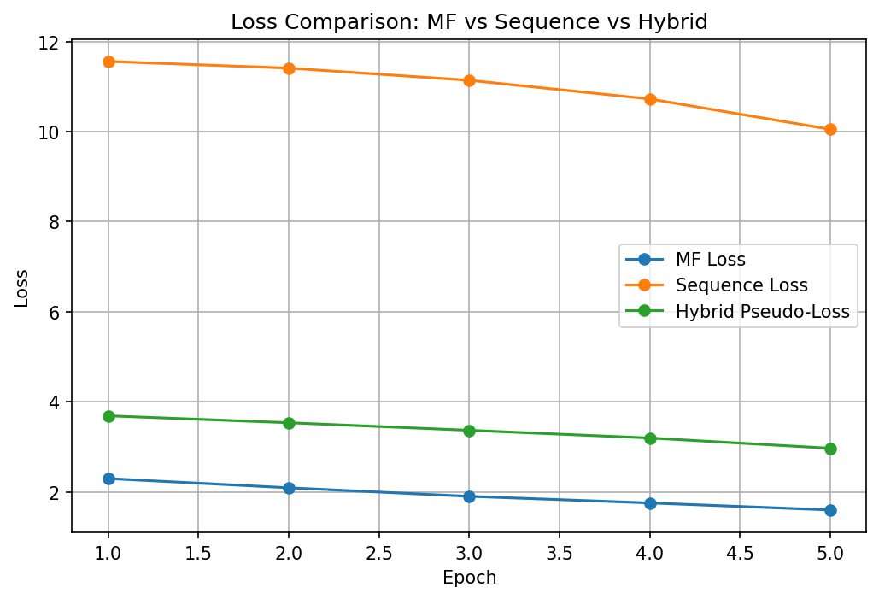
GR22-A Novel Community and Family Centric Healthy Meal Planner Integrating Nutritional Information, User Preferences, and Regional Context
Results and Performance Metrics
1. Performance Evaluation Criteria
Model performance is evaluated using training loss convergence across epochs.
Loss measures the error between:
Predicted user–food interaction scores
Actual interaction signals
Decreasing loss indicates:
Effective preference learning
Stable optimization
Performance comparison is done across:
Matrix Factorization
Transformer Sequence Model
Hybrid Recommendation Model
22-12-2025
@Dept. of CSE, TMSL
35

Slide 36
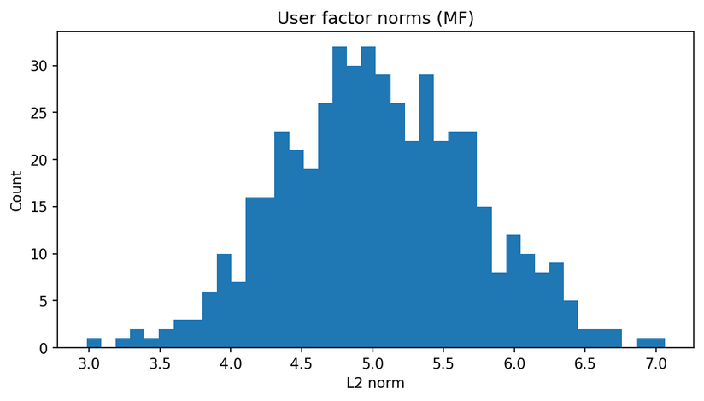
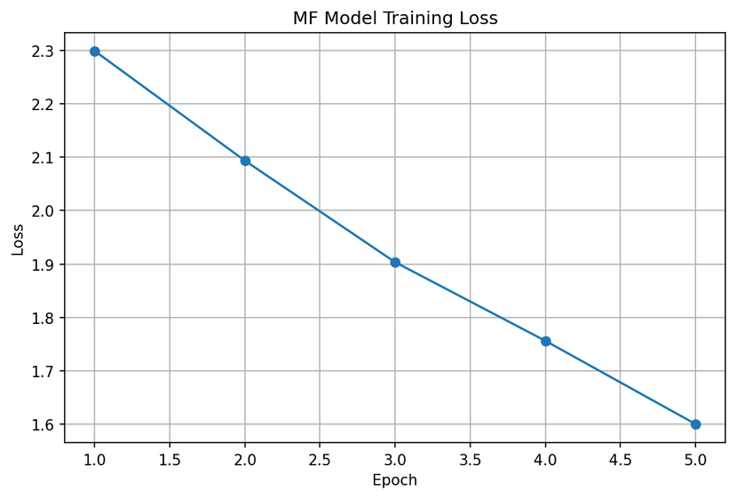
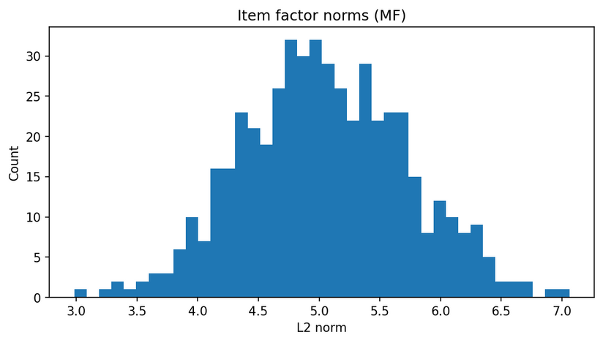
GR22-A Novel Community and Family Centric Healthy Meal Planner Integrating Nutritional Information, User Preferences, and Regional Context
Result Analysis
Matrix Factorization – Training Performance
MF trained using Binary Cross-Entropy Loss
Shows fast and stable convergence
Learns long-term user–food preferences
Embedding norms indicate stable latent representations
22-12-2025
@Dept. of CSE, TMSL
36

Slide 37
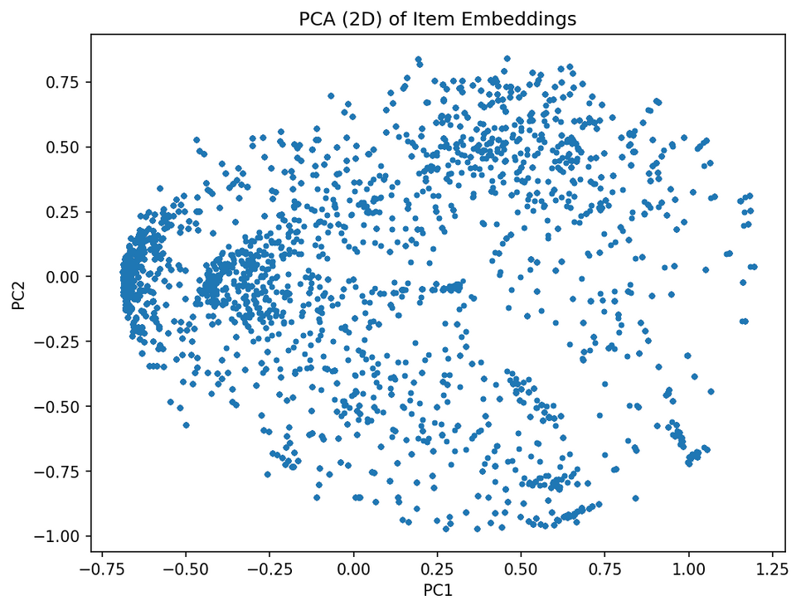
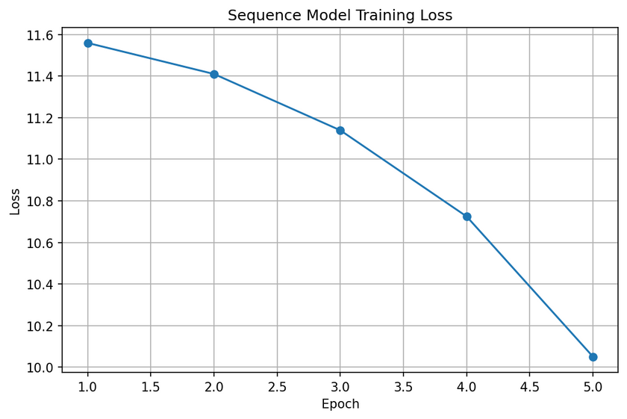
GR22-A Novel Community and Family Centric Healthy Meal Planner Integrating Nutritional Information, User Preferences, and Regional Context
Result Analysis
Transformer Sequence Model – Training Performance
Trained using Cross-Entropy Loss
Higher initial loss due to sequential prediction complexity
Learns short-term eating behavior
PCA shows structured food embedding space
22-12-2025
@Dept. of CSE, TMSL
37

Slide 38
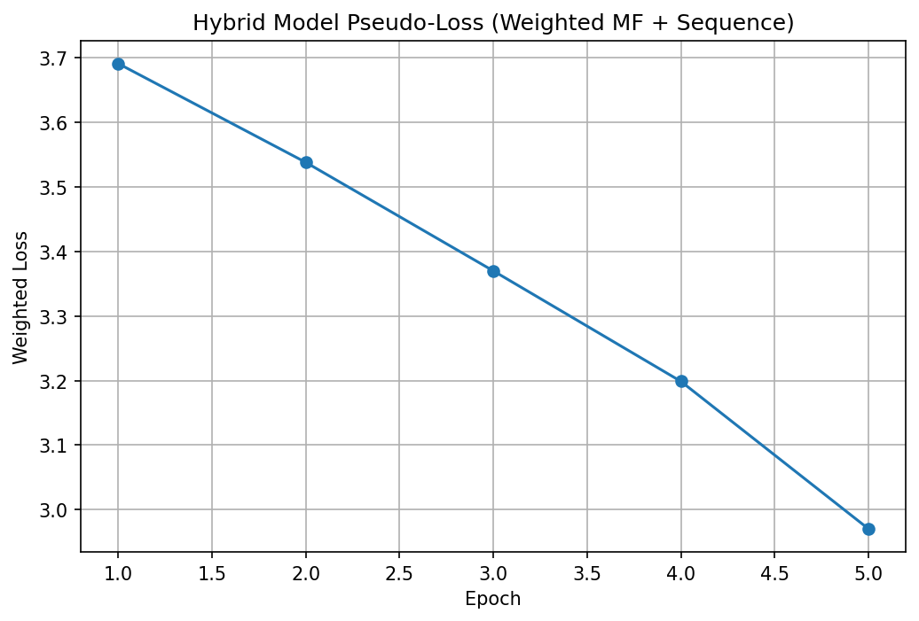
GR22-A Novel Community and Family Centric Healthy Meal Planner Integrating Nutritional Information, User Preferences, and Regional Context
Result Analysis
Hybrid Recommendation Model – Performance
Hybrid model combines MF + Sequence + Content scores
Not trained directly
Pseudo-loss used for evaluation
Shows smoother and more stable convergence
22-12-2025
@Dept. of CSE, TMSL
38

Slide 39


GR22-A Novel Community and Family Centric Healthy Meal Planner Integrating Nutritional Information, User Preferences, and Regional Context
Result Analysis
Loss Function Summary
MF Loss: Binary Cross-Entropy
Sequence Loss: Cross-Entropy
Hybrid Loss:
Hybrid loss used only for visualization
22-12-2025
@Dept. of CSE, TMSL
39

Slide 40
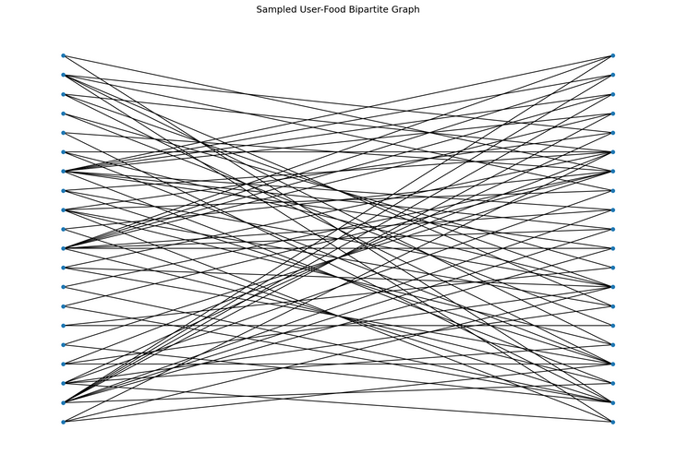
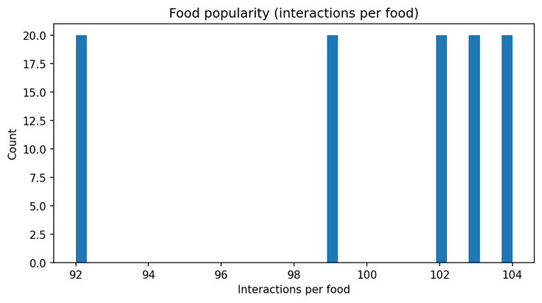
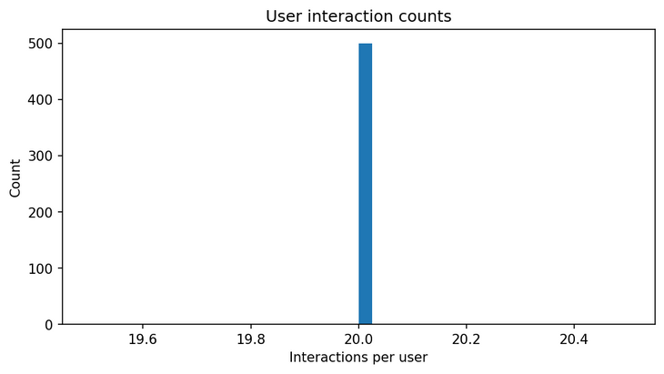
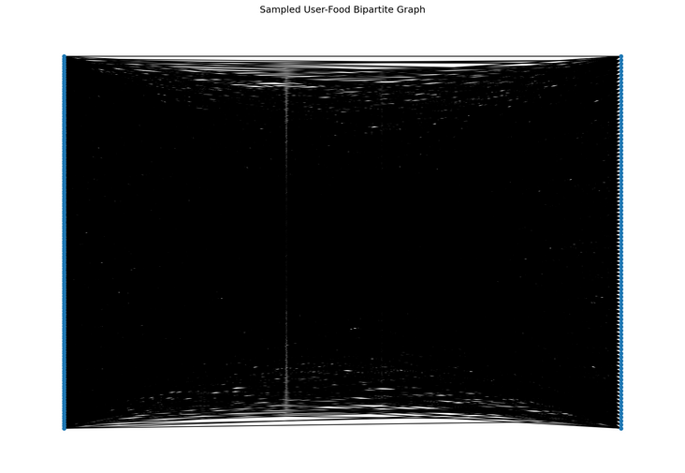
GR22-A Novel Community and Family Centric Healthy Meal Planner Integrating Nutritional Information, User Preferences, and Regional Context
Result Analysis
User–Food Interaction Analysis
User–food interactions modeled as bipartite graph
Shows food popularity skew
Shows variation in user activity
Justifies collaborative filtering
22-12-2025
@Dept. of CSE, TMSL
40

Slide 41
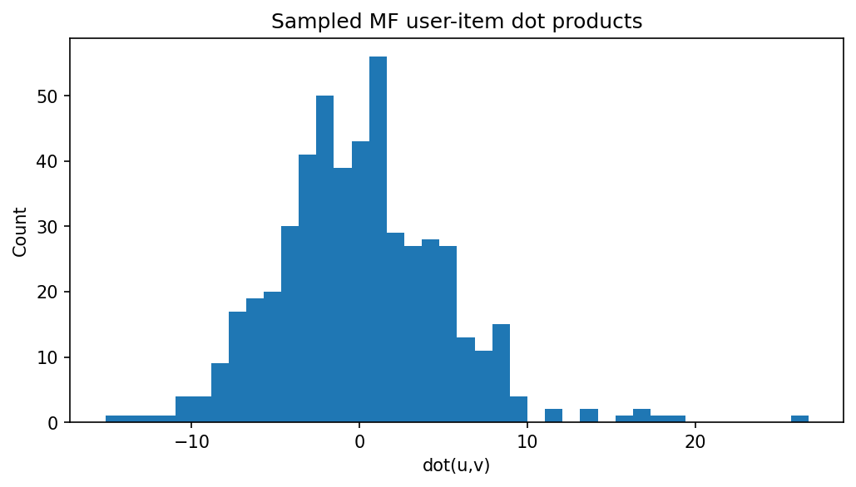
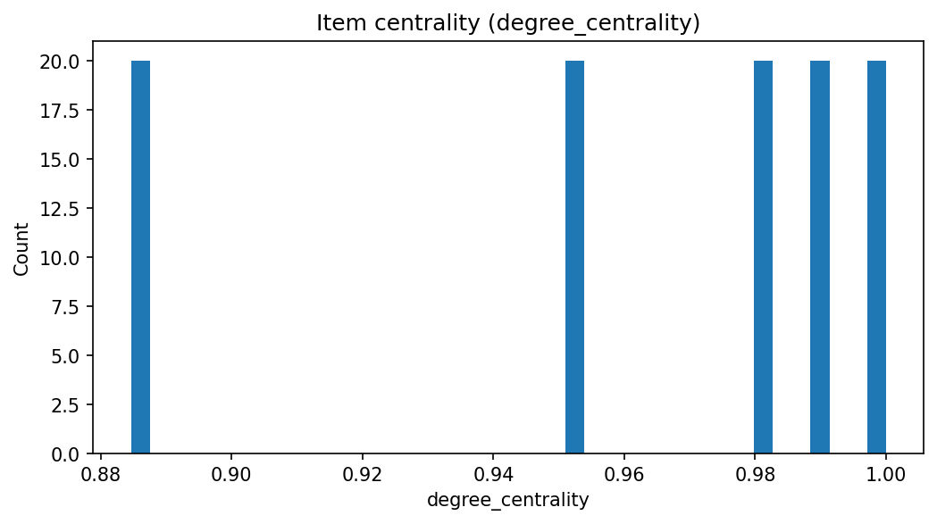
GR22-A Novel Community and Family Centric Healthy Meal Planner Integrating Nutritional Information, User Preferences, and Regional Context
Result Analysis
Item Centrality & Popularity Analysis
Centrality distribution highlights popular food items
Dot-product distribution shows MF scoring behavior
Confirms effective interaction modeling
22-12-2025
@Dept. of CSE, TMSL
41

Slide 42
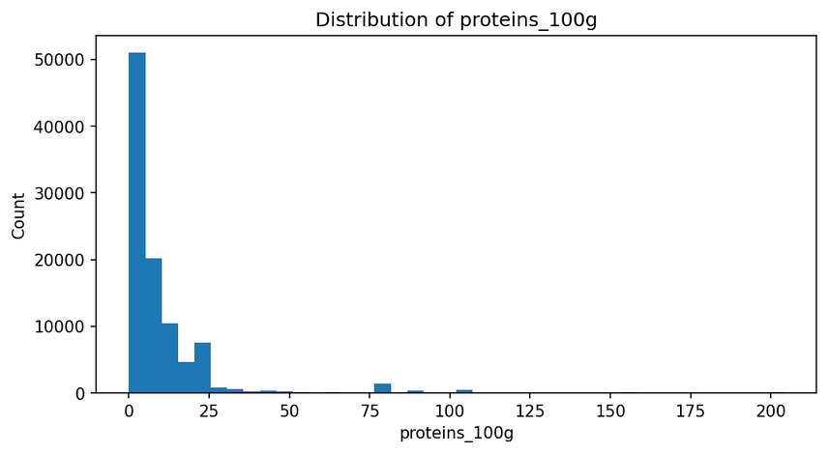
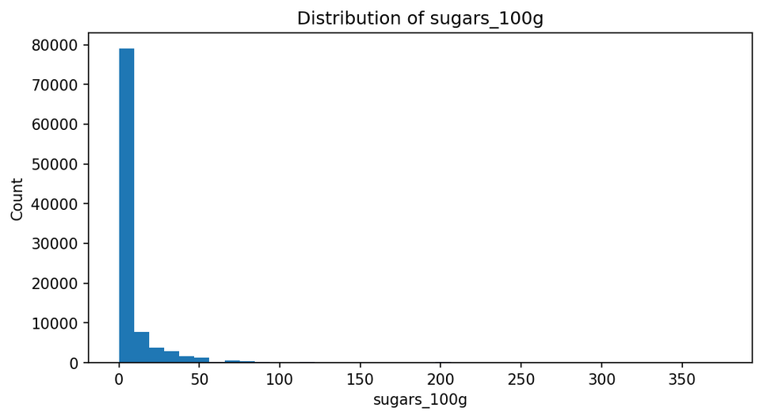
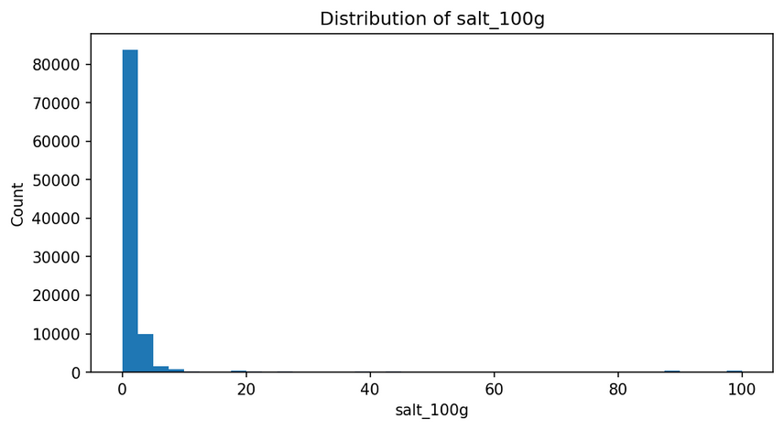
GR22-A Novel Community and Family Centric Healthy Meal Planner Integrating Nutritional Information, User Preferences, and Regional Context
Result Analysis
Nutrition Feature Distribution
Nutrient values show realistic distributions
Supports health-aware filtering
Prevents extreme bias in recommendations
22-12-2025
@Dept. of CSE, TMSL
42

Slide 43
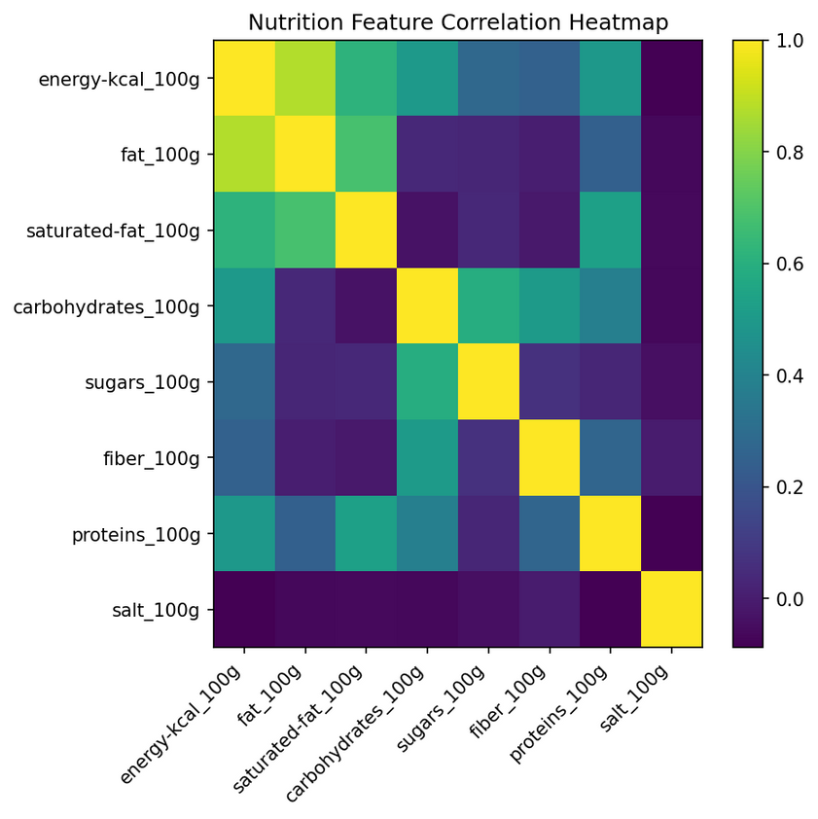
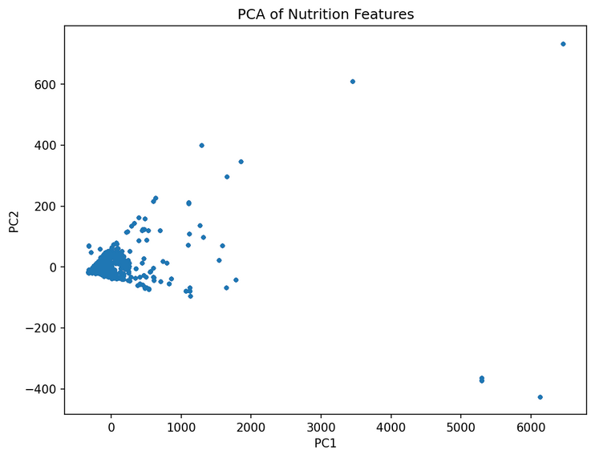
GR22-A Novel Community and Family Centric Healthy Meal Planner Integrating Nutritional Information, User Preferences, and Regional Context
Result Analysis
Nutrition Feature Correlation
Correlation heatmap reveals relationships between nutrients
PCA shows reduced dimensional representation
Confirms non-redundant nutritional features
22-12-2025
@Dept. of CSE, TMSL
43

Slide 44
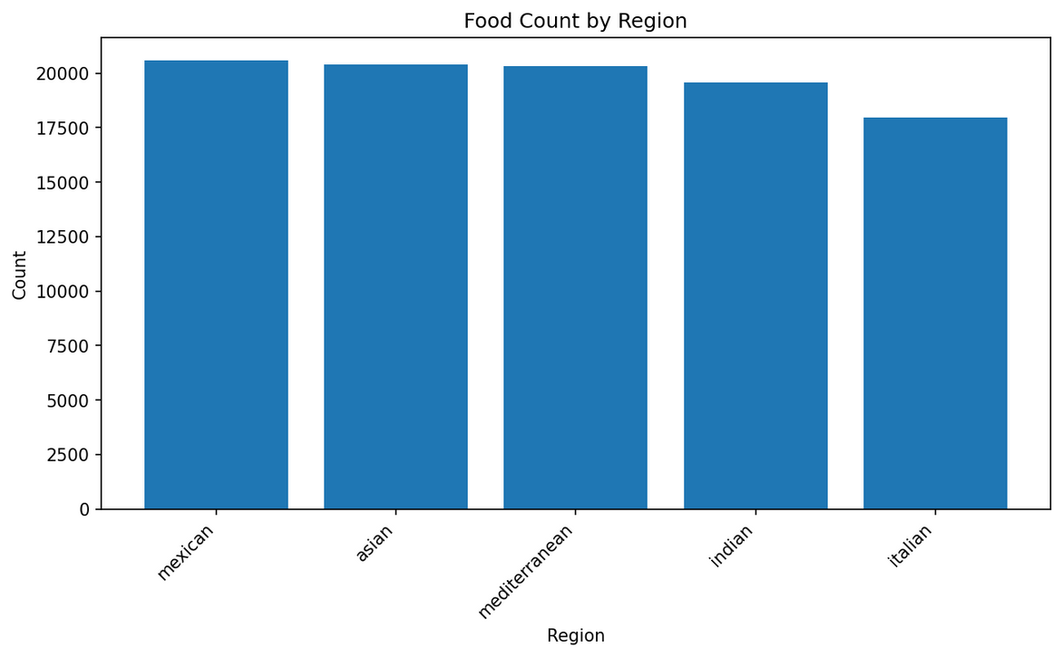
GR22-A Novel Community and Family Centric Healthy Meal Planner Integrating Nutritional Information, User Preferences, and Regional Context
Result Analysis
Regional Distribution Analysis
Food items distributed across regions
Enables region-aware recommendations
Prevents cultural bias
22-12-2025
@Dept. of CSE, TMSL
44

Slide 45
GR22-A Novel Community and Family Centric Healthy Meal Planner Integrating Nutritional Information, User Preferences, and Regional Context
Result Analysis
Final Results Summary
MF: Fast convergence
Transformer: Captures temporal behavior
Hybrid: Best stability and balance
Ensures personalization, health, and safety
22-12-2025
@Dept. of CSE, TMSL
45

Slide 46
GR22-A Novel Community and Family Centric Healthy Meal Planner Integrating Nutritional Information, User Preferences, and Regional Context
Future Scope
Family-Centric Meal Planning: The system can be extended to support family-level recommendations by aggregating nutritional needs across different age groups, health conditions, and dietary preferences, enabling balanced meal planning for households.
Complete Meal Scheduling: Future versions can generate structured daily and weekly meal plans (breakfast, lunch, dinner) with calorie and macro-nutrient balancing based on health goals and activity levels.
Integration of Demographic and Lifestyle Data: Incorporating demographic attributes such as age, gender, occupation, and lifestyle patterns can improve personalization and allow more precise nutritional recommendations.
Real-Time Health & Wearable Integration: Integration with wearable devices and health apps can enable dynamic adjustment of meal recommendations based on real-time activity, calorie expenditure, and health metrics.
Explainable and Adaptive Recommendation System: Future improvements can include explainable AI components to justify food recommendations and reinforcement learning mechanisms to adapt recommendations based on user feedback over time.
22-12-2025
@Dept. of CSE, TMSL
46

Slide 47
GR22-A Novel Community and Family Centric Healthy Meal Planner Integrating Nutritional Information, User Preferences, and Regional Context
Conclusion
Key Findings:
Successfully developed a region-aware and health-constrained food recommendation prototype.
Effective integration of nutritional data, user health conditions, allergies, activity level, and health goals into the recommendation process.
Hybrid recommendation logic enables personalized yet safe and culturally relevant food suggestions.
The prototype demonstrates strong potential for scalable and extensible meal recommendation systems.
Impact:
Promotes health-conscious and informed dietary decision-making.
Reduces the risk of unsuitable food choices for users with specific health constraints.
Establishes a solid foundation for future family-centric and community-level meal planning systems.
Can be extended to real-world healthcare, wellness, and smart nutrition platforms.
22-12-2025
@Dept. of CSE, TMSL
47

Slide 48
GR22-A Novel Community and Family Centric Healthy Meal Planner Integrating Nutritional Information, User Preferences, and Regional Context
References
[1] M. Rostami, M. Oussalah, and V. Farrahi, “A Novel Time-Aware Food Recommender-System Based on Deep Learning and Graph Clustering,” IEEE Ac-cess, vol. 10, 2022, doi: 10.1109/ACCESS.2022.3175317. [Online]. Available: https://ieeexplore.ieee.org/document/9775081
[2] Y. Chen, Y. Guo, Q. Fan, Q. Zhang, and Y. Dong, “Health-Aware Food Recom-mendation Based on Knowledge Graph and Multi-Task Learning,” Foods, vol. 12, no. 10, art. no. 2079, 2023, doi: 10.3390/foods12102079.
[3] S. Forouzandeh, M. Rostami, K. Berahmand, and R. Sheikhpour, “Health-aware food recommendation system with dual attention in heterogeneous graphs,” Com-puters in Biology and Medicine, vol. 169, art. no. 107882, Feb. 2024, doi: 10.1016/j.compbiomed.2023.107882.
[4] Y. Tian, C. Zhang, Z. Guo, C. Huang, R. Metoyer, and N. V. Chawla, “RecipeRec: A Heterogeneous Graph Learning Model for Recipe Recommendation,” in Proc. Int. Joint Conf. on Artificial Intelligence (IJCAI), 2022. [Online]. Available: https: //arxiv.org/abs/2205.14005
[5] X. Ju, F. P. W. Lo, J. Qiu, P. Shi, J. Peng, and B. Lo, “MenuAI: Restaurant Food Recommendation System via a Transformer-based Deep Learning Model,” arXiv preprint arXiv:2210.08266, 2022. [Online]. Available: https://arxiv.org/abs/2210.08266
[6] M. Rostami, V. Farrahi, K. Berahmand, S. Forouzandeh, S. Ahmadian, and M. Oussalah, “A Novel Explainable and Health-aware Food Recommender System,” in Proc. Int. Conf. on Health Informatics (HEALTHINF), 2022. [Online]. Available: https://www.scitepress.org/Papers/2022/115617/115617.pdf
[7] S. Ahmadian, M. Rostami, S. M. J. Jalali, M. Oussalah, and V. Farrahi, “HealthyFood Recommendation Using a Time-Aware Community Detection Approach and Reliability Measurement,” International Journal of Computational Intelligence Sys-tems, vol. 15, art. no. 105, 2022, doi:10.1007/s44196-022-00168-4.
[8] I. Papastratis, D. Konstantinidis, P. Daras, and K. Dimitropoulos, “AI nutrition recommendation using a deep generative model and ChatGPT,” Scientific Reports, vol. 14, art. no. 14620, 2024, doi: 10.1038/s41598-024-65438-x.
[9] Z. Kwan, W. Zhang, Z. Wang, A. B. Ng, and S. See, “Nutrition Estimation for Dietary Management: A Transformer Approach with Depth Sensing,” arXiv preprintarXiv:2406.01938, 2024. [Online]. Available: https://arxiv.org/abs/2406.01938
[10] L. Liu, Y. Guan, Z. Wang, R. Shen, G. Zheng, X. Fu, X. Yu, and J. Jiang, “An interactive food recommendation system using reinforcement learn-ing,” Expert Systems with Applications, vol. 254, art. no. 124313, Nov. 2024, doi:10.1016/j.eswa.2024.124313.
22-12-2025
@Dept. of CSE, TMSL
48

